Slide 1
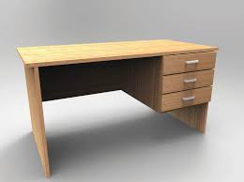
1
2
3
4
5
6
7
8
9
Notes:
Click on a numbered square to make the square disappear.
Click on the image to reveal it. All the squares will disappear.

Slide 2
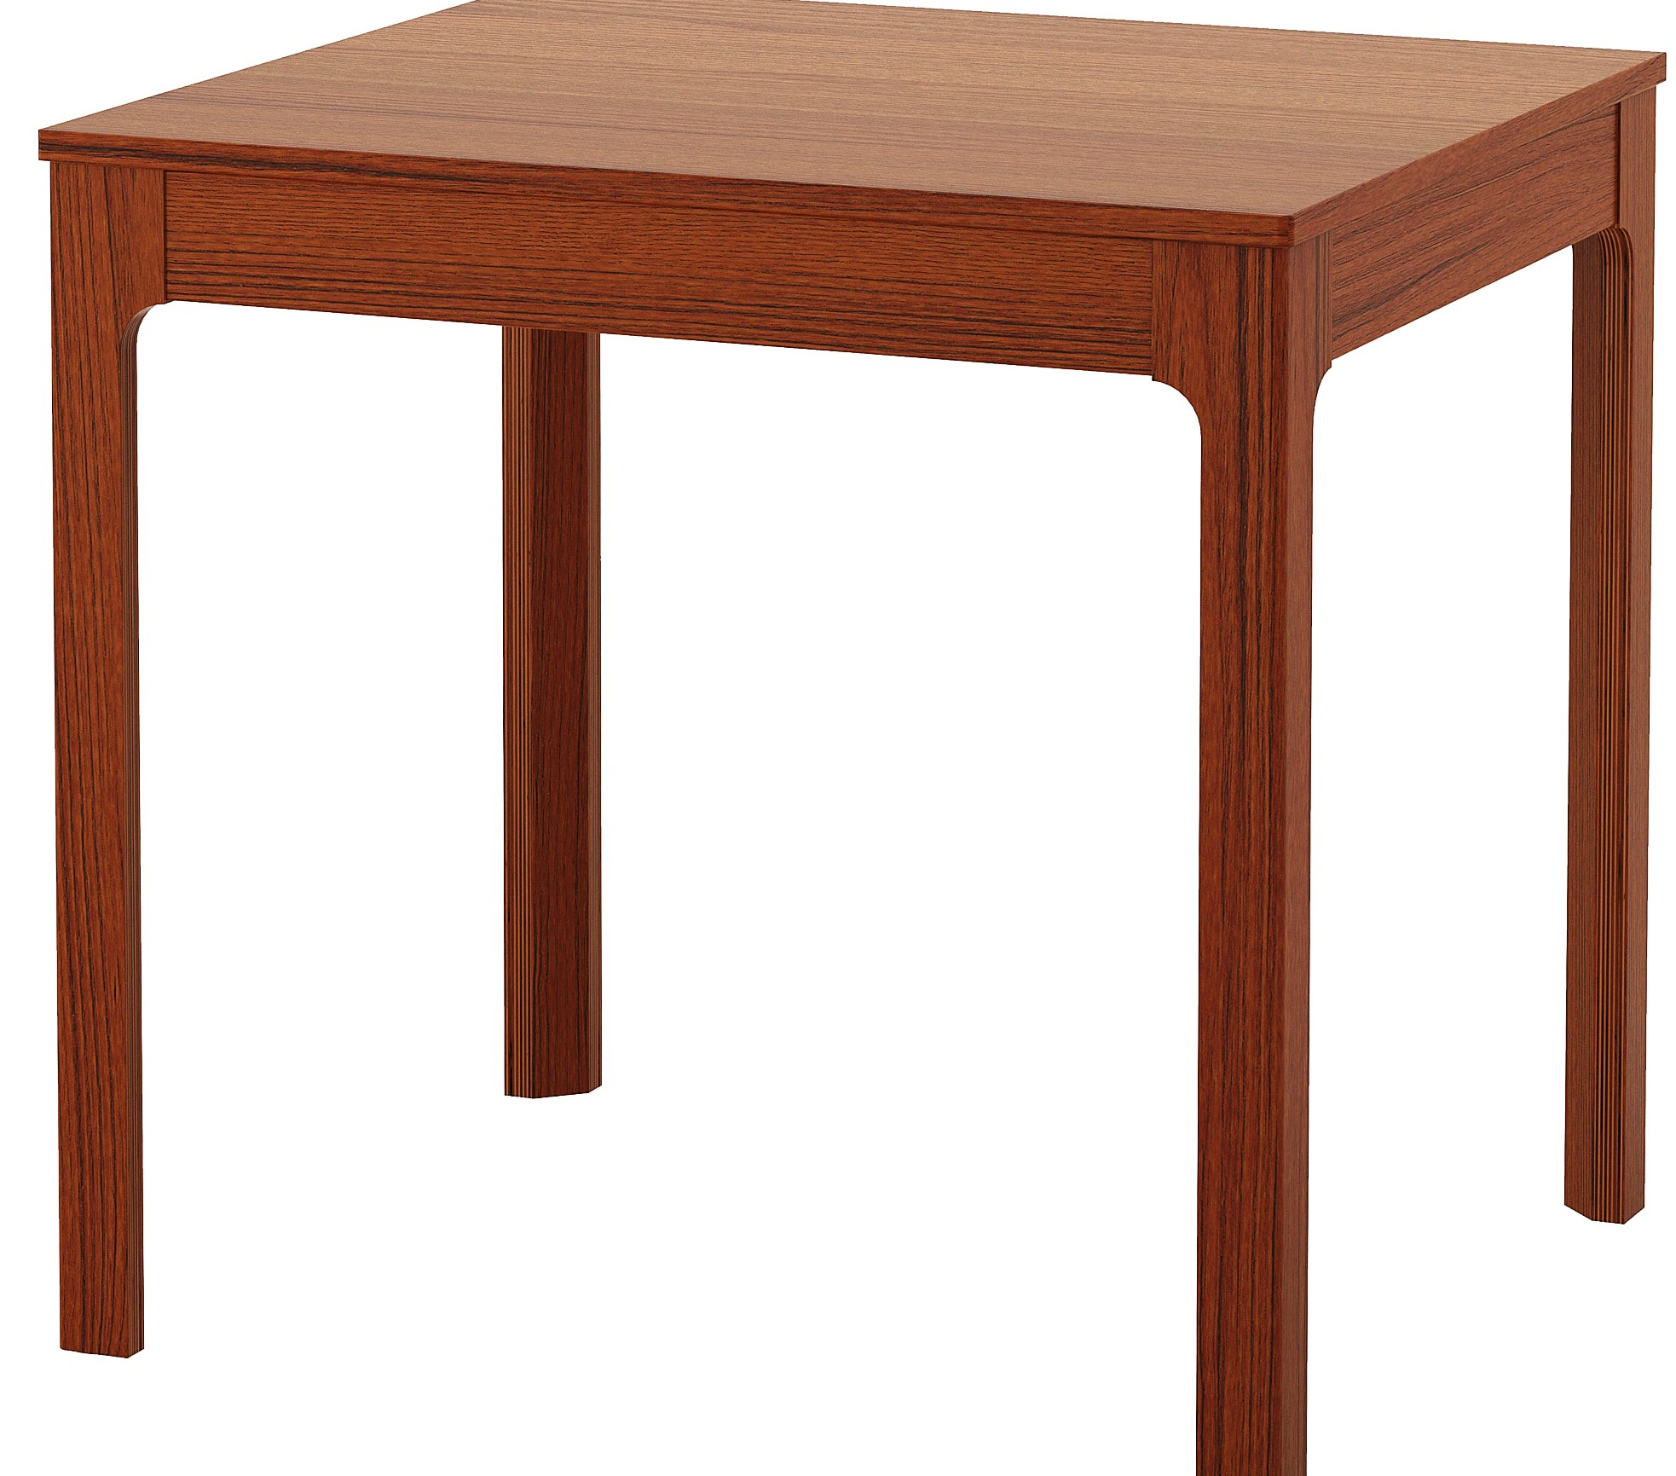
1
2
3
4
5
6
7
8
9
10
11
12
13
14
15
16
17
18
Notes:
Click on a numbered square to make the square disappear.
Click on the image to reveal it. All the squares will disappear.

Slide 3
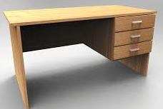
1
2
3
4
5
6
7
8
9
10
11
12
13
14
15
16
17
18
19
20
21
22
23
24
25
26
27
28
29
30
31
32
33
34
35
36
Notes:
Click on a numbered square to make the square disappear.
Click on the image to reveal it. All the squares will disappear.

Slide 4

1
2
3
4
5
6
7
8
9
10
11
12
13
14
15
16
17
18
19
20
21
22
23
24
25
26
27
28
29
30
31
32
33
34
35
36
37
38
39
40
41
42
43
44
45
46
47
48
49
50
51
52
53
54
55
56
57
58
59
60
61
62
63
64
65
66
67
68
69
70
71
72
Notes:
Click on a numbered square to make the square disappear.
Click on the image to reveal it. All the squares will disappear.

