Slide 1
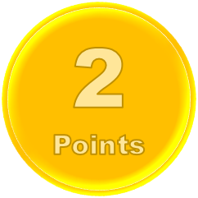

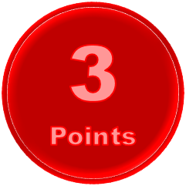
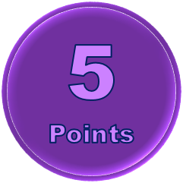

A sentence with Ate
Past of take
A sentence with make
Past of buy
Negative past of do
Past of finish
Past of leave
Past of ride
A sentence with send
Past of say
Past of catch
Give a sentence with got
past of wear
past of forecast
Past of find
A sentence with shake
A sentence expresses
surprise
A sentence with wear
past of become
A sentence with gave
tekhnologic

Slide 2
A sentence with present
Past of hide
A sentence with teach
past of know
negative past of know
Past of give
Past of learn
Past of keep
A sentence with see
Past of tell
Past of show
A sentence with think
past of understand
Past of wear
Past of win
A sentence with wrote
A sentence expresses
opinion
A sentence with grow
past of dream
A sentence with gave
tekhnologic

